Slide 1
Energy Working Group (Arbeitskreis Energie, AKE) in the German Physical Society (DPG)
Prof. Dr. Hardo Bruhns
University of Heidelberg
Chairman AKE

Slide 2
Overview
DPG:
~ 70.000 members (research, industry, education)
Organised in sections (condensed matter, …)
which are managed dominantly by representatives of research institutes (public, industry).
Extra sections for physicists in industry and secondary education (teachers).
Energy is cross-disciplinary to the established sections.
It is recognised that the historical structure of sections should be revised.
Each member can adhere to two divisions

Slide 3
Energy Working Group (AKE)
Arbeitskreis Energie:
Established 1979 as a working group, attained the status of a DPG-division in 1989
~ 1.500 members (2014)
Managed by a Board of typically 8 members, therof Chair and 2 Co-chairs
Chair: H. Bruhns
Co-Chairs: M. Keilhacker , K.-F. Ziegahn
Board: H. Bruhns (U. Heidelberg), B. Buchal (Jülich), W. Breyer (Kerntext, co-opted), G Luther (Research Center Future Energies, U. Saarbrücken)), M. Keilhacker (Munich), B. Rech (Helmholtz-Zentrum Berlin, M. Treber (German Watch), K.-F. Ziegahn, KIT Karlsruhe

Slide 4
AKE Activites
Meetings, Conferences
Internal meetings:
Spring and fall working sessions in the Physics-Centre (Bad Honnef near Bonn), typically noon Thursday to noon Friday, In-depth discussions of actual energy topcis
Annual conference of the DPG:
one week, 4,000 – 7,500 participants
AKE organises a programme-track on energy topics, typically 2 days long,
Purpose: dissemination of high-level information on energy issues.
~20 invited talks from a broad range of energy themes
Contributed talks (in future possibly also posters)
Participation rose over past six years from max 100 to close to 1000 attendees of talks

Slide 5
AKE Activities
Studies on energy issues
2005: climate aspects of energy production and use
2010: Electricity – key to a sustainable development
Proceedings of the AKE at the annual DPG conferences
based on invited oral presentations
Articles and energy briefs e.g. for publication in the PhysikJournal or the Information bulletin (PhysikKonkret) of the DPG
Other publications, presentations to the public

Slide 6
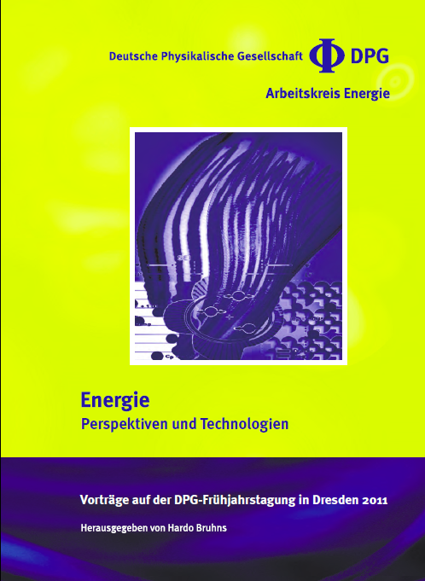
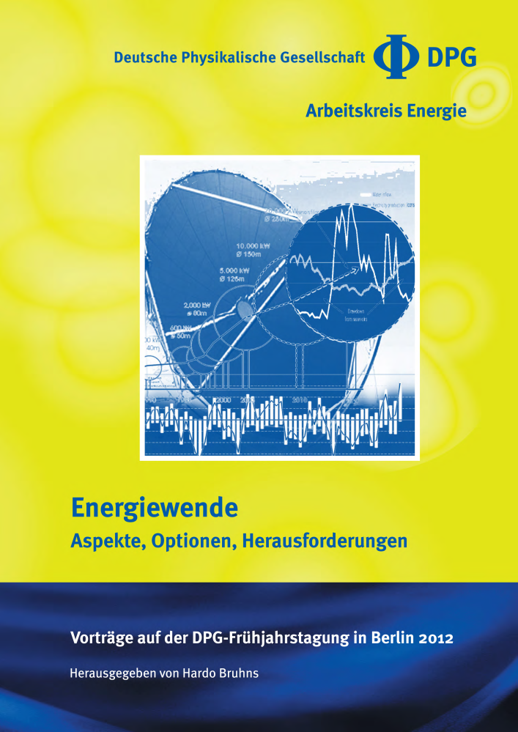
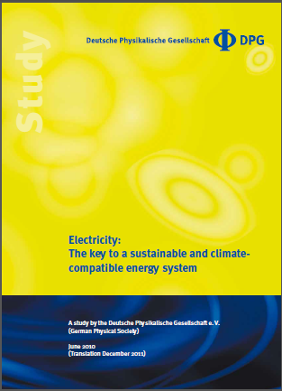
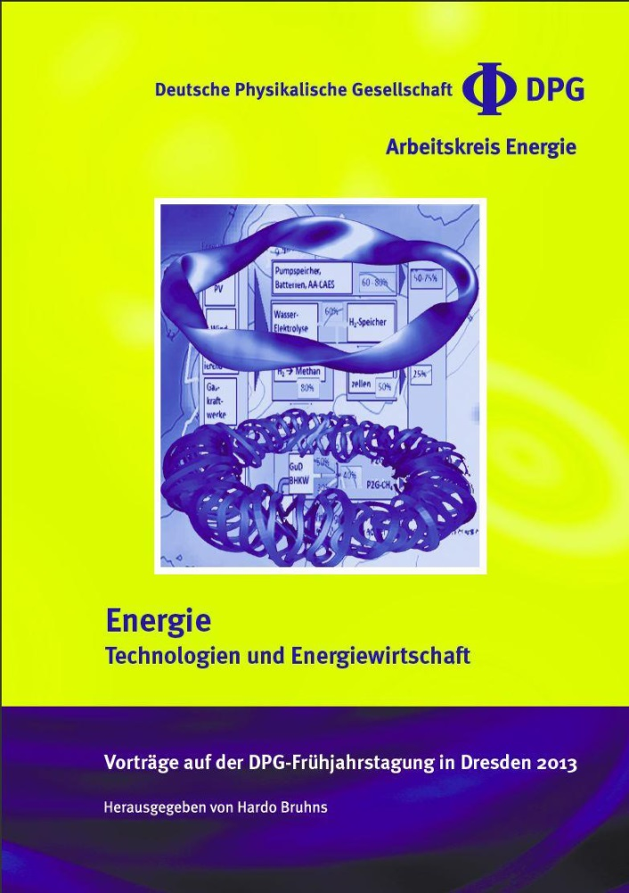
www.dpg-physik.de
Vorhersagen sind sehr schwierig
…
besonders die Zukunft betreffend.
Niels Bohr

Slide 7
AKE Activities
Providing advice to the DPG
Support of actions of the DPG vis à vis decision makers
Keep-in-touch with other societies (in particular the chemical societies),
participation in joint studies

Slide 8
An example: AKE at the DPG annual conference, Berlin 2014
Energy and Society (joint session with other sections)
Meeting the Energy Challenge Steve Chu, former US Secretary of Energy, Nobel Prize Winner)
Economical Aspects of Energy
Design of the Electricity Market. Challenges and Concepts (Felix Höffler, Univ. Köln)
Mobility
Electrochemistry for Sustainable Mobility (Jochen Friedl, TUM CREATE, Singapore)
Grid Technologies
Integration of Renwable Energies (Albert Moser, RWTH Aachen)
Supraleitung in der Energietechnik (Matthias Noe, Karlsruher Inst. f. Technologie)

Slide 9
An example: AKE at the DPG annual conference 2014
Renewable Energy
Bioenergie in der zukünftigen Energieversorgung (Daniela Thrän, Deutsches Bioforschungszentrum Leipzig)
New Green Chemistry – Methangewinnung ohne Biomassebildung (Christian Wilhelm, Univ. Leipzig)
Photovoltaics – A Pure Silicon Story (Jürgen Werner, Univ. Stuttgart)
Organic Photovoltaics: With tailored materials to future technology (Peter Bäuerle, Univ. Ulm)
Small is beautiful, big is better: Wind Energy Development (Po Wen Cheng, Univ. Stuttgart)
Marine Energy – Stand und Perspektiven (Jochen Bard, Fraunhofer IWES, Kassel)
Geothermie für Wärme- und Stromversorgung (Kemal Erbas, Deutsches GeoForschungZentrum Potsdam)
Design of a fully renewable European Energy System for Europe (Martin Greiner, Aarhus University, Denmark)

Slide 10
An example: AKE at the DPG annual conference 2014
Nuclear Fission
Die Internationale Rolle der Kernspaltungsenergie: Stand und Perspektiven (Robert Stieglitz, Karlsruher Institut für Technologie)
Nuclear Fusion
Nuclear Fusion Using Magnetic Confinement, Status and Prospects (Hartmut Zohm, MPI f. Plasmapyhsik, Garching)
Fusion mit Laser- und Teilchenstrahlung für die Stromerzeugung, Stand und Perspektiven (Markus Roth, TU Darmstadt)
Fossil Fuels
Unconventional Gas: Potential und Rahmenbedingungen in Deutschland (Michael Kosinowski, Bundesanstalt f. Geowissenschaften und Rohstoffe, Hannover)
Gashydrates: Perspektiven und Risiken für Energiegewinnung und CO2-Speicherung (Judith Schicks, Deutsches GeoForschungsZentrum Potsdam)

Slide 11
An example: AKE at the DPG annual conference 2014
Symposium „Rare Events: Optimal Solutions and Challenges – from Charge Transfer Reactions to Supervolcanoes“ (leading, jointly with other sections)
Rare and large events: examples from the natural sciences and economics (Thomas Guhr, Univ. Duisburg-Essen)
The role of energy-level and elecronic couplingfluctuations in the control of biomolecular and small molecule charge transfer reactions (Spiros Skourtis, Univ. Cyprus)
What do we know about extreme solar events? (Ilya Usoskin, Univ. Oulu, Finland)
Climate Impact of Very Large Volcanic Eruptions: An Earth System Model Approach (Claudia Timmreck, MPI f. Meteorologie, Hamburg, Vortrag fiel wegen Erkrankung aus)

Slide 12
An example: AKE at the DPG annual conference 2014
Symposium “Physics for the Energy Turn” (mainly dedicated to the secondary education sector)
Meeting the Energy Challenge – (some detailed aspects, Steve Chu, Univ. California)
Energy Transformation Pathways towards 2° C Stabilization (Gunnar Luderer, Potsdam Institute for Climate Impact Research)
How can Physicists contribute to the Energy Transformation? (Eicke Weber, Fraunhofer ISES, Freiburg)
Photosynthesis – Lessons from Nature (Rienk van Grondelle, VU University, Amsterdam)
Questions and Perspectives for Highschool Physics and Young Researchers (Gerwald Heckmann, Asam-Gymnasium München)

